Slide 1

Sanjivani College of Engineering,Kopargaon-423603 (An Autonomous Institute Affiliated to Savitribai Phule Pune University, Pune) (NAAC ‘A’ Grade Accredited, ISO 9001:2015 Certified)
Department of Information Technology
mini project
On python

Slide 2
INTRODUCTION
Group Members Guided By: PROF. D. P. Bhamare.
Abhishek Kusalkar [UIT20M1037]
Varun Patil [UIT20M1045]
Piyush Shinde UIT20M1057]
Jayavant Warkhade UIT20M1071]

Slide 3
PROBLEM STATEMENT
To Create Bus Seat Reservation System

Slide 4
Objective
The software program “Online Bus Reservation System” provides bus transportation system, a facility to reserved seats, cancellation of seats and different types of enquiry which need an instant and quick reservation. OBTRS is built for manage and computerize the traditional database, ticket booking and tracking bus and travel made easy.
We feel some drawbacks of offline bus reservation system so to overcome this we build Online Bus Reservation System

Slide 5
Implementation
Key Functional Requirements
identify requirements
Plan according to
Analysis For Each Module
Decide how to present Output
Start Coding Module Wise
Test in Proper Way

Slide 6
Implemented by 2 Ways
1)Without GUI
(CSV module and user defined module imported)
2)With GUI
(modules Imported:- 1)tkinter
2)Random
3)time
4)datetime
5)sqlite3

Slide 7
FUNCTIONAL REQUIREMENT
For Without GUI
Bus Company Name
Bus contact Number
Bus Address
Departure
Destination
Date and Day
Passenger name
No of passenger
Seat no
Bus Type(AC/Non AC)
Boarding point address
Total fare
Departure time

Slide 8
Project Structure & File Names
Without GUI
Passengerinfo.py
TicketShow.py
Admin.py
main.py
With GUI
Index.py

Slide 9
CLASSES USED
ClassName = PassengerRegistration
Attribute in class
passengerName
noOfPassenger
departureLocation
destinationLocation
selectDay
selectSeatNo
selectBusType
busFare
autoInc
countCol
Class Name = PassengerDataCsv
Here we will save the data on csv file permanently
Class Name = TicketShow
After Booking we can check the ticket
Class Name = Admin

Slide 10
FUNCTIONAL REQUIREMENT For With GUI
For Accessing :- Login ID and Password
For Performing :-
FirstName
Surname
Address
Postcode
Telephone
Mobile
Email
Bus Type
Ticket Side
Pickup
Drop
TAX
Luggage
Insurance
Distance
Subtotal
total

Slide 11
GUI Program Structure
Login/New Account
Class Travel(Defining Attribute)
Define Function(receipt , bus_tax,reset ,exit ,kilo, lug, selectbus, totalpaid)
Code For Frames in GUI
Assigning Buttons According to Needs And Accepting Input
Setting Screen Width

Slide 12
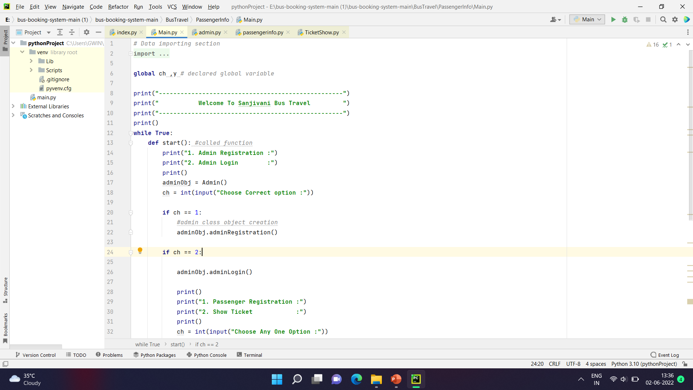

Slide 13
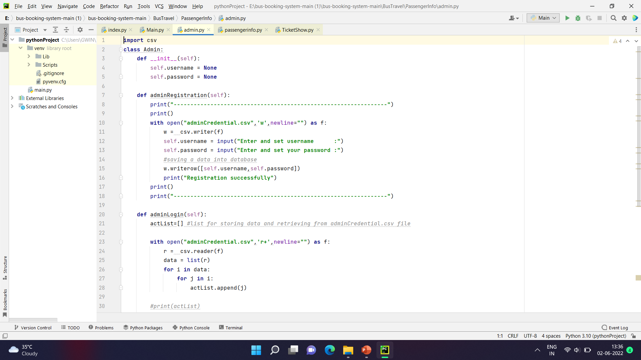

Slide 14
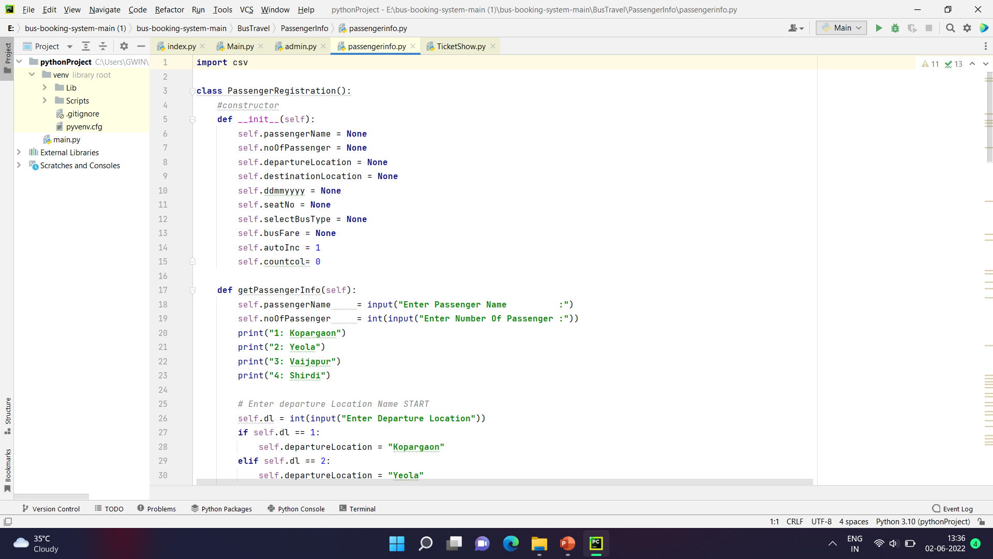

Slide 16
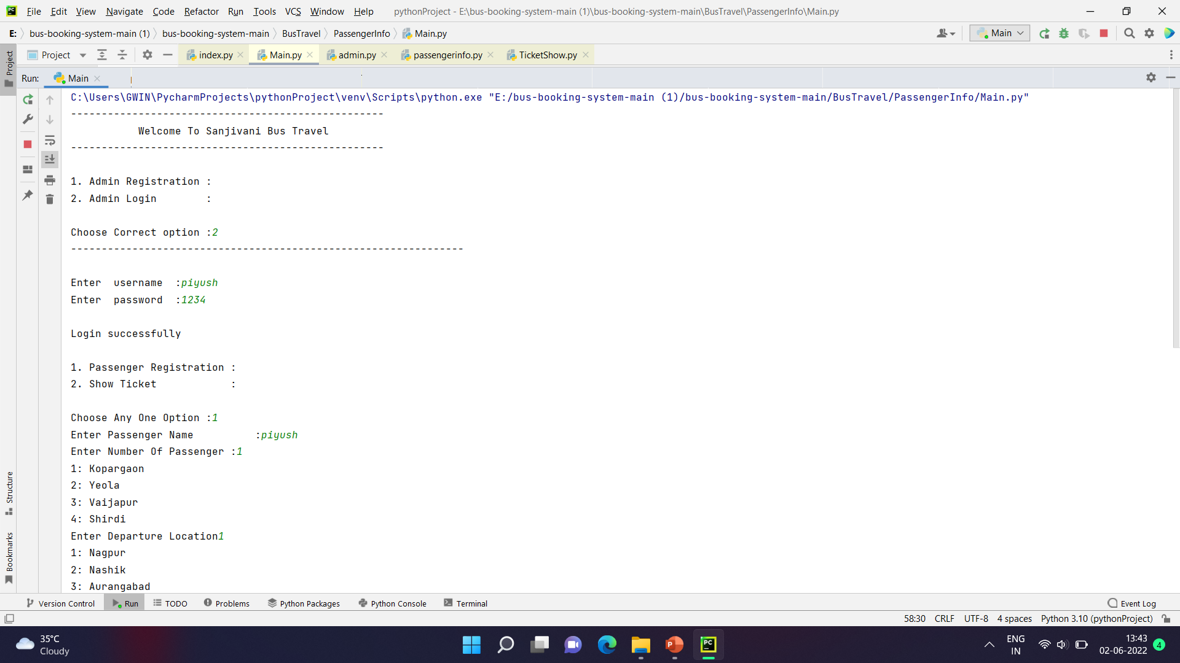

Slide 17
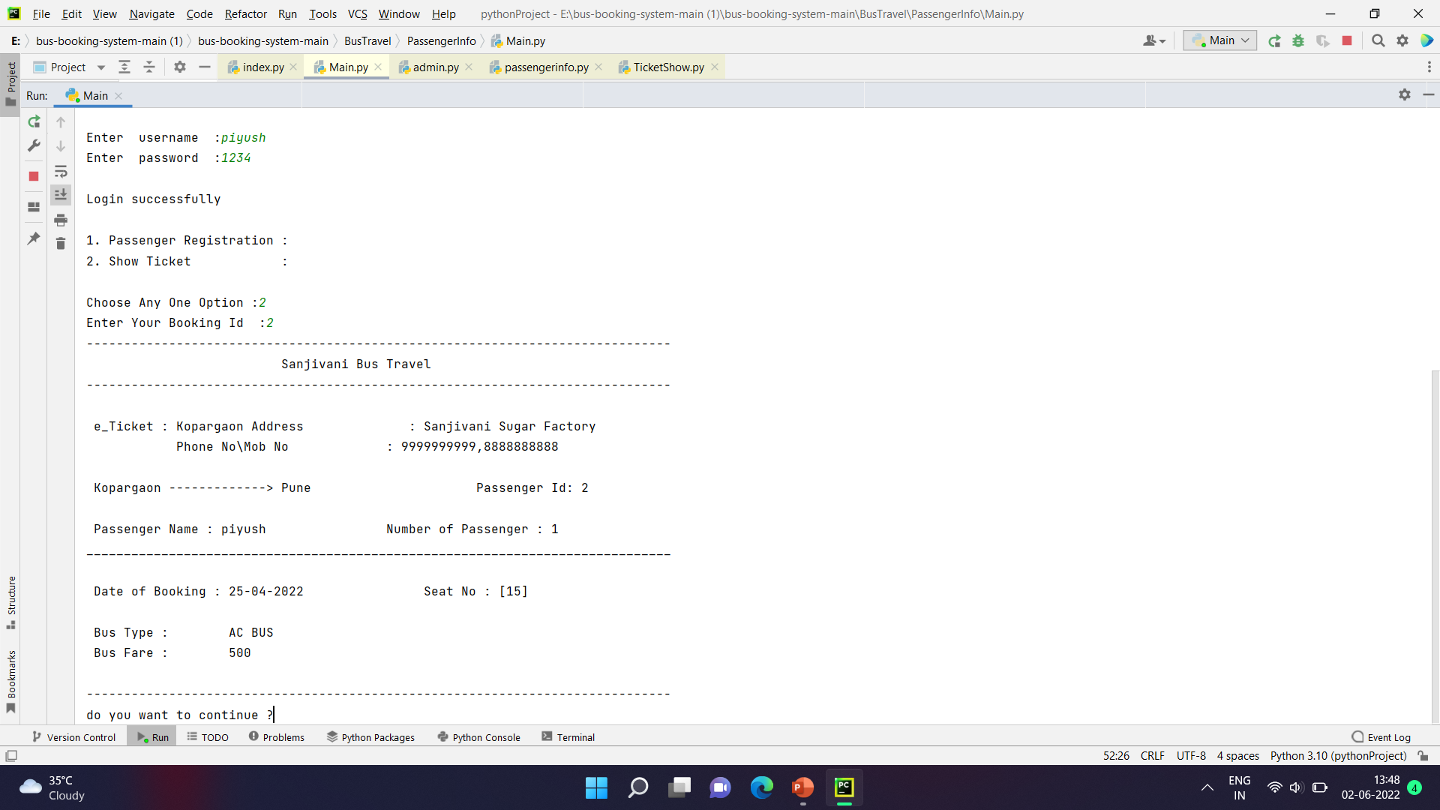

Slide 18
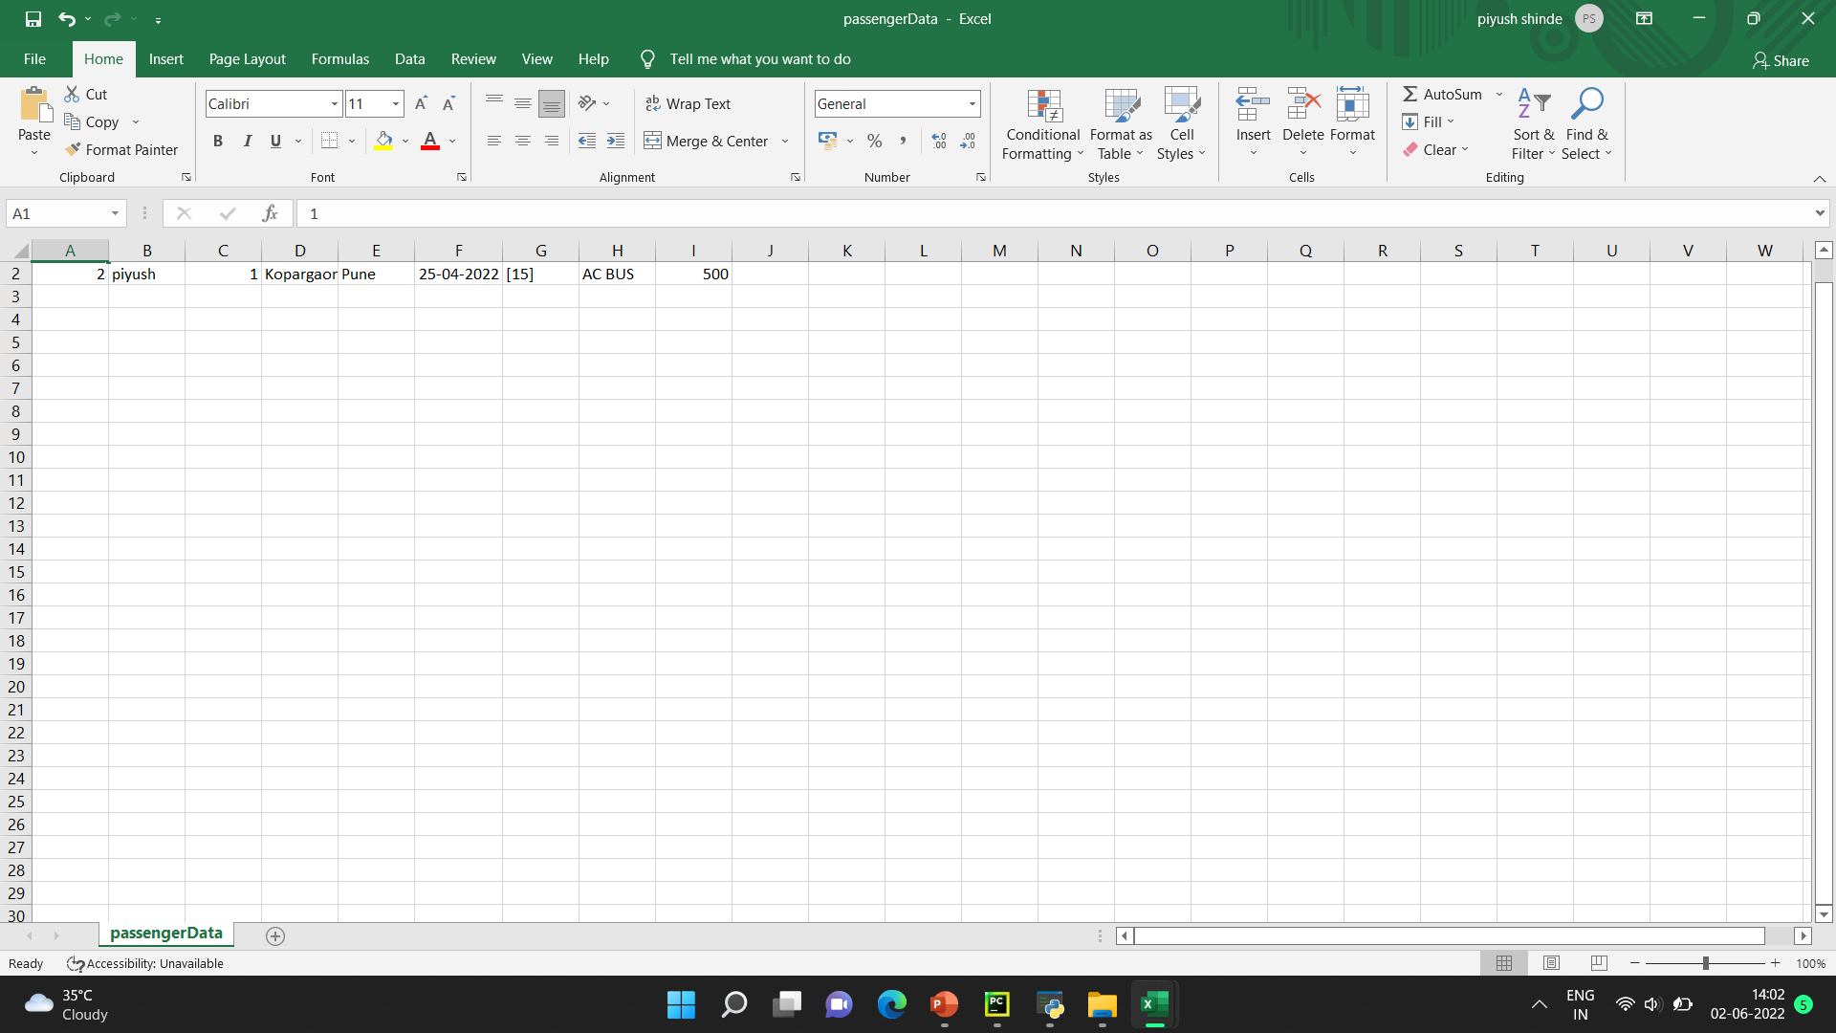
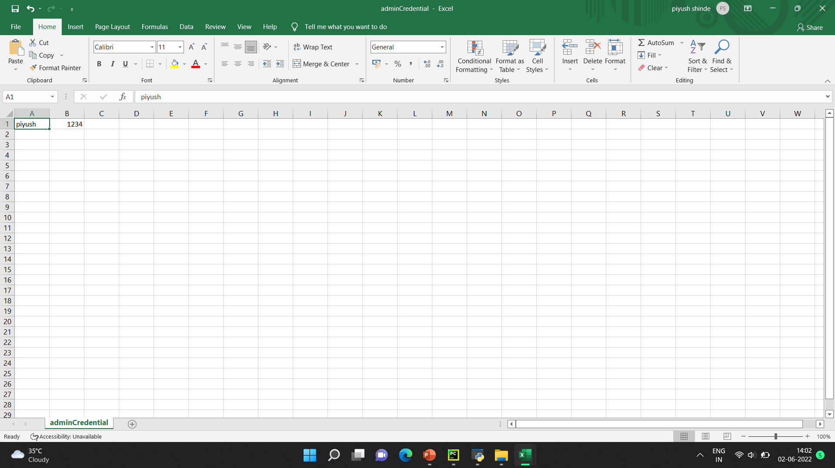

Slide 19
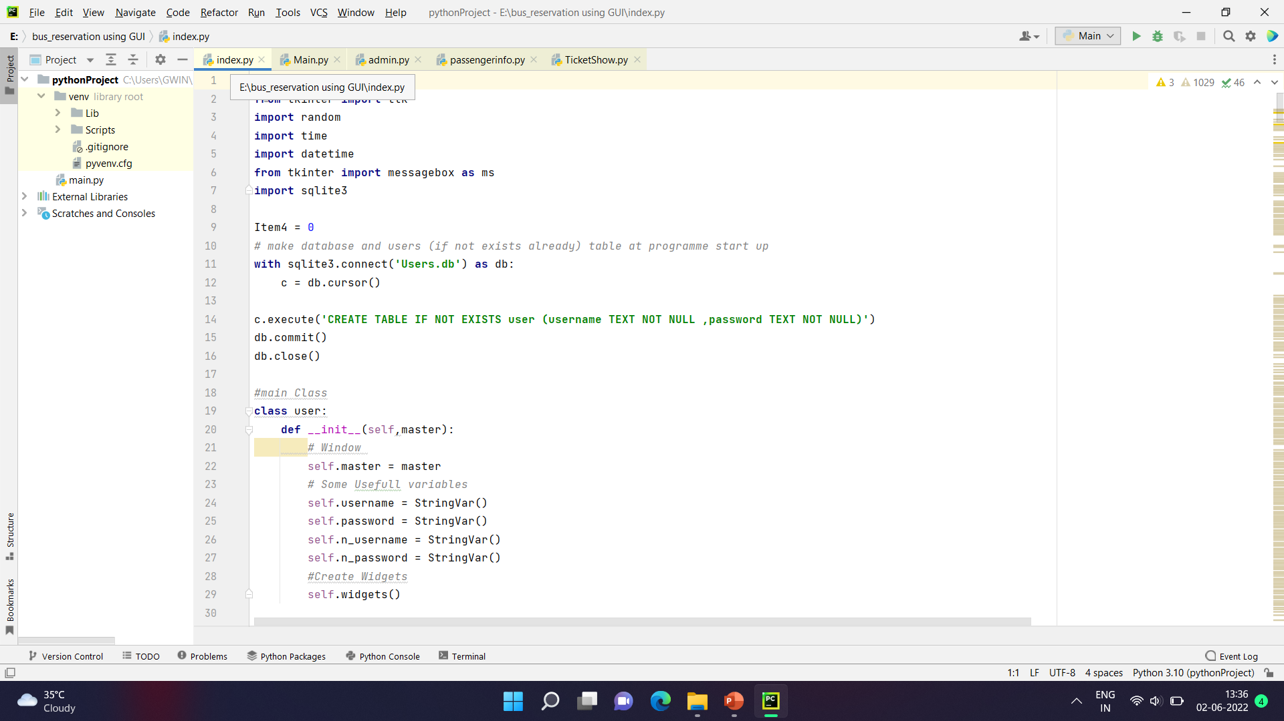

Slide 20
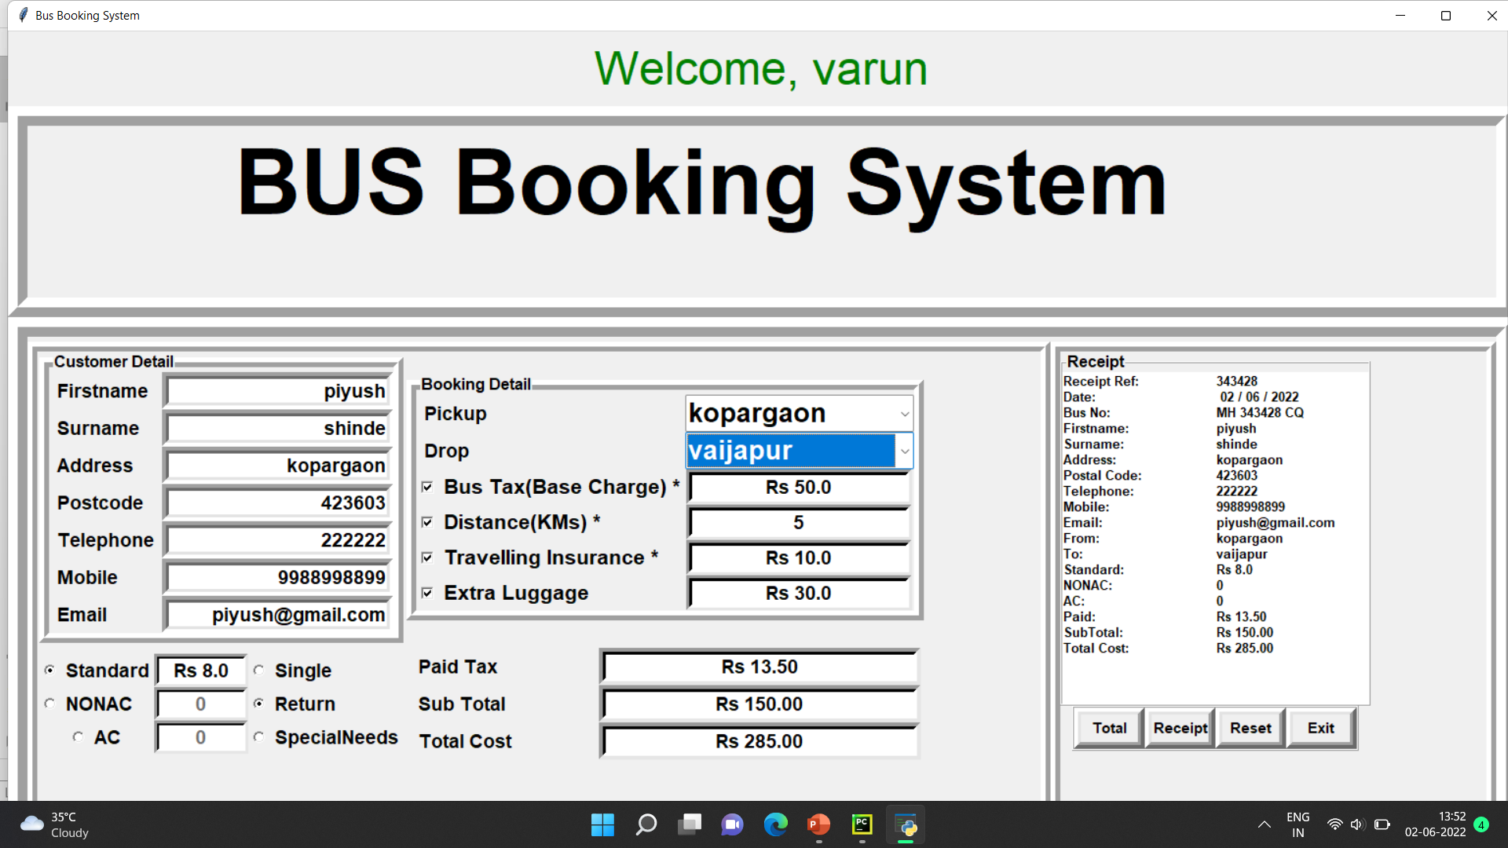

Slide 21
Advantages
User Accounts to control the access and maintain security
Easy To use
Attachments & Additional Comments for more information
Accuracy in work.
Easy & fast retrieval of information.
Decrease the load of the person involve in existing manual system.
Access of any information individually.
Work becomes very speedy.
Easy to update information

Slide 22
Conclusion
By Implementing Online bus reservation system we reduce the manual job to check ticket of each passenger , book a ticket physically, no case of loss of ticket .
Just require Id and Password to Check ticket and Book ticket .
Can Access Data At any Time anywhere.
Not require to bring print of ticket.

Slide 23
THANK YOU

